Slide 1

Transient Response on PM Motor Connected to A Micro-Grid
E. Hildenbrandt, D. Davis, J. Brownlee
3/3/25
Advanced Electrical Machine Dynamics
For Smart-Grid Systems
1

Slide 2
Contents
Background
Scope of Study
Methods of Analysis
Results and Discussion
Q&A
3/3/25
Advanced Electrical Machine Dynamics
For Smart-Grid Systems
2

Slide 3
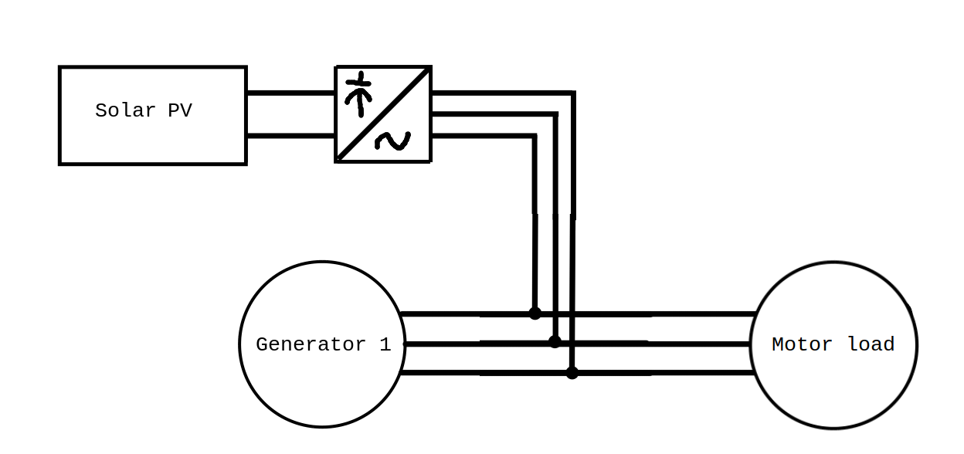
Introduction
Why is this important?
  With DER’s becoming more popular in microgrid applications its important to understand how they affect stability and reliability.
  Inverters have poor fault tolerance [1]
Objective
  Study how microgrids with high renewable penetration react to a sudden loss in renewable energy production.
3/3/25
Advanced Electrical Machine Dynamics
For Smart-Grid Systems
3

Slide 4
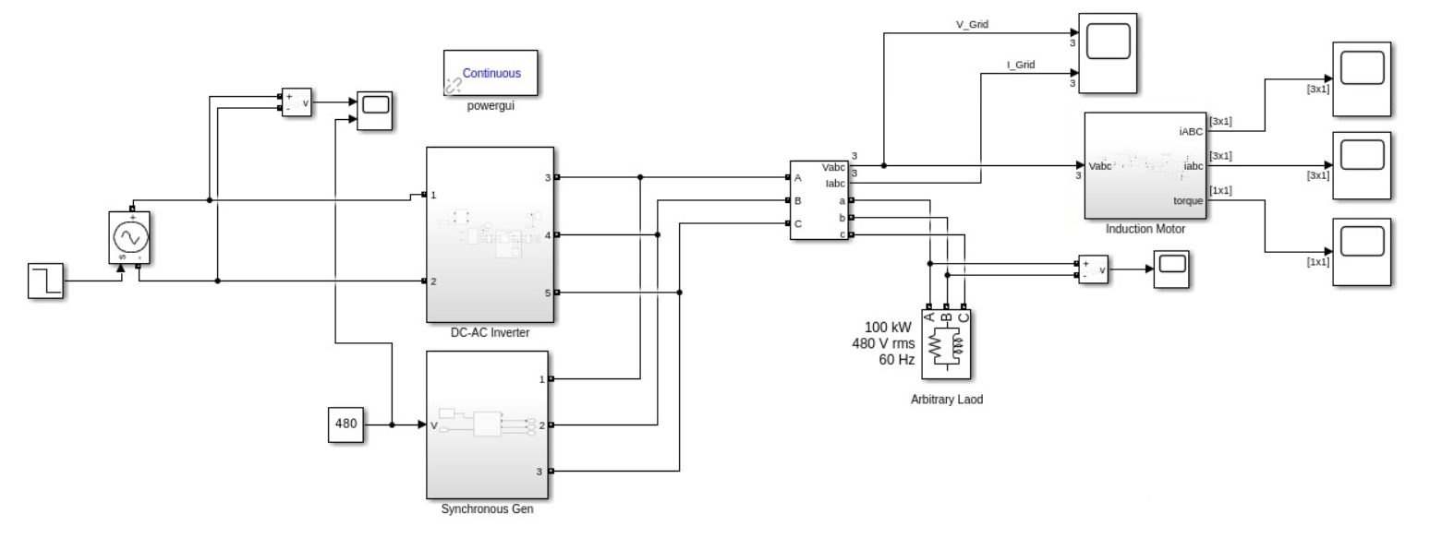
Simulation
Overall layout of Simulink
  DC-AC PV inverter, Synchronous Generator, Induction Motor/Three Phase Load
  Power generation and consumption is delta connected
  Measured transient in PM motor induced torque
3/3/25
Advanced Electrical Machine Dynamics
For Smart-Grid Systems
4

Slide 5
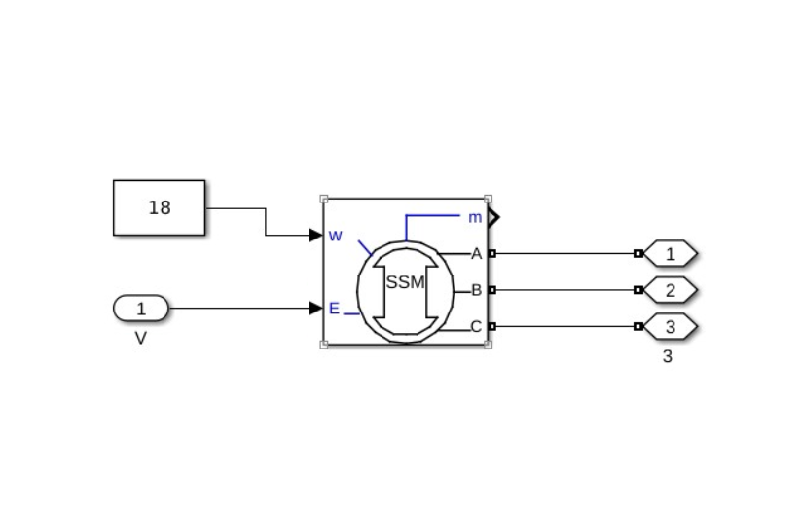
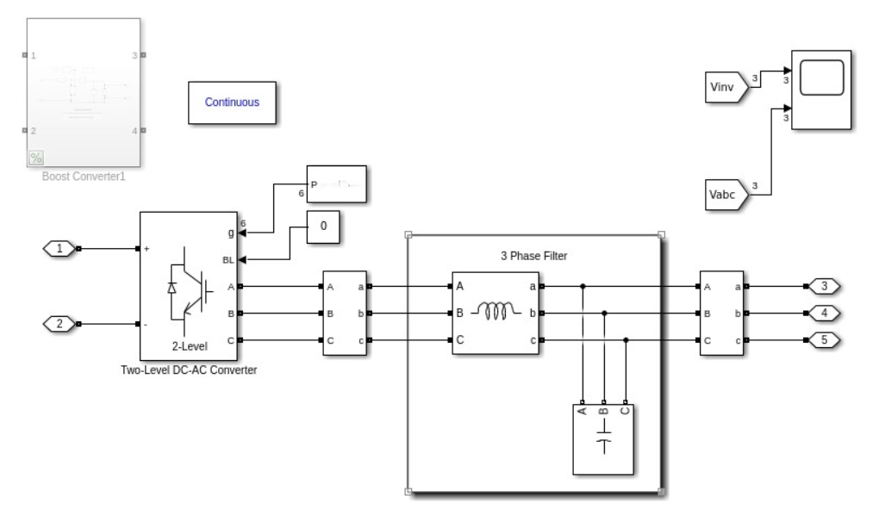
Synchronous Generation and DC-AC Inverter
Built-in synchronous generator
Inverter used Two-Level Converter with 3 phase PWM generator
  Signal is passed through an LC filter to smooth the phase voltages
  Inductance and Capacitance values are selected such that the cutoff frequency is higher than the operation frequency of the system
3/3/25
Advanced Electrical Machine Dynamics
For Smart-Grid Systems
5

Slide 6
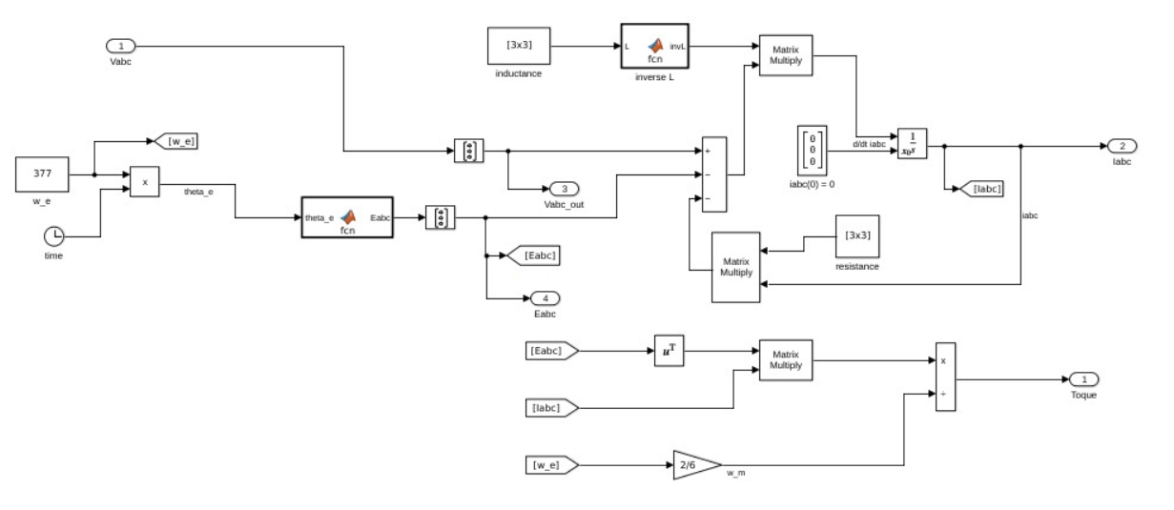
State Space Model of PM Motor
Internal generated voltage is a function of rotor angle
  Equivalent representation of a field winding around the rotor with constant field current
Line voltage is used as the input
3/3/25
Advanced Electrical Machine Dynamics
For Smart-Grid Systems
6

Slide 7
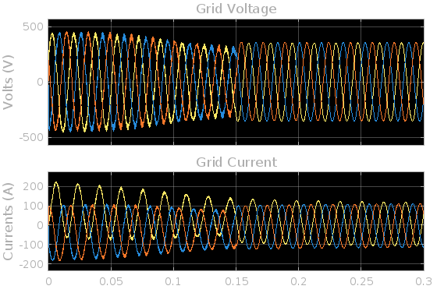
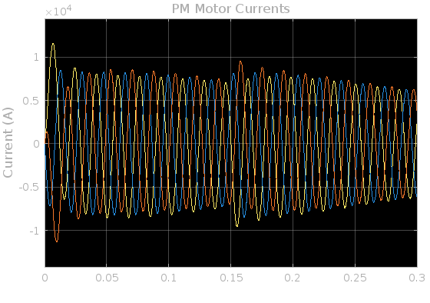
Preliminary Analysis on Grid and Motor Voltages
DC offset in the transient current per phase, which is expected for PM motors [2].
Low frequency harmonics present on phase voltages from Inverter Model
  Inverter cuts out at 0.15 seconds
3/3/25
Advanced Electrical Machine Dynamics
For Smart-Grid Systems
7

Slide 8
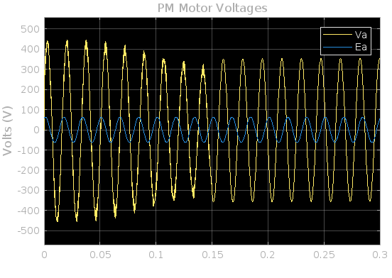
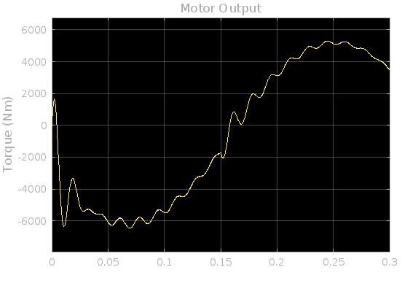
Preliminary Analysis on SS Model of PM Motor
Equivalent representation of a field winding around the rotor with constant field current
High frequency oscillations present on PM motor induced torque
Very low rotational speed on PM motor
3/3/25
Advanced Electrical Machine Dynamics
For Smart-Grid Systems
8

Slide 9
Results
PM Motor and Torque Response
  The PM motor has a fixed internally generated voltage (EA), acting as part of the forcing function.
  This is modeled as a fictitious field winding with a fixed excitation winding
  This setup may make the PM motor resilient to sudden changes in armature winding currents.
Observations on the permanent magnet motor do not indicate transient electromagnetic stresses on the machine when power from the PV inverter is decreased given the simulated mode of operation
3/3/25
Advanced Electrical Machine Dynamics
For Smart-Grid Systems
9

Slide 10
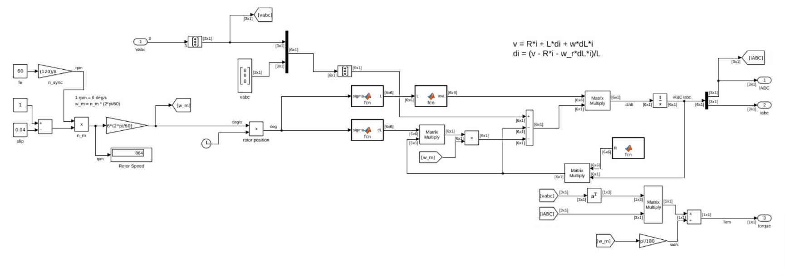
Alternative Load : Induction Motor
Replace PM Motor with Induction Motor
Forcing Function of the SS model is the Bus voltage established by the PV Inverter and Synchronous Generator
  Motor has per phase stator inductance, stator resistance, rotor inductance, and rotor resistance
3/3/25
Advanced Electrical Machine Dynamics
For Smart-Grid Systems
10
Notes:
Eric

Slide 11
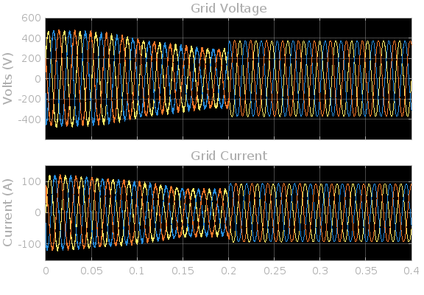
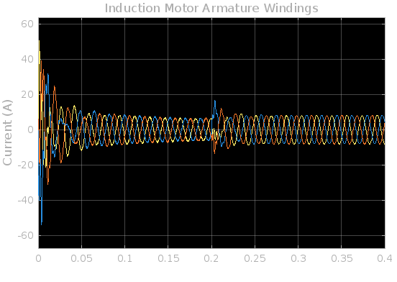
Grid and Induction Motor Voltages
Grid shows sinusoidal three phase voltages from the inverter and synchronous generator
Stator currents on the induction motor have transient response when the machine is attached to the grid at start time and when the inverter shuts off
3/3/25
Advanced Electrical Machine Dynamics
For Smart-Grid Systems
11
Notes:
Eric

Slide 12
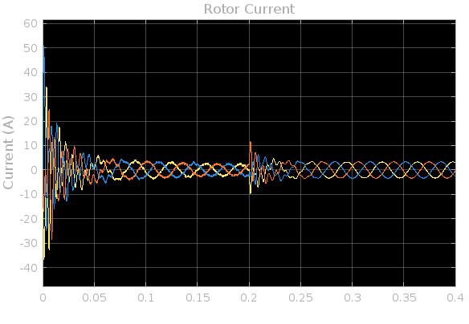
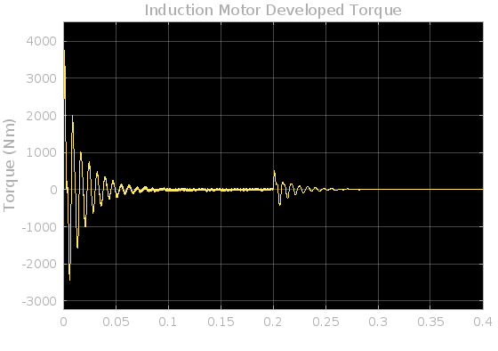
Analysis on Induction Motor
Motor shows transients in the developed torque when first connection to the grid and when there is change in the voltage levels on the grid
Rotor induced currents are connected to the armature winding currents through the flux linkage
  Induction motor has zero no-load torque during steady state neglecting windage, friction, core and copper losses
3/3/25
Advanced Electrical Machine Dynamics
For Smart-Grid Systems
12
Notes:
Eric

Slide 13
Observations
Inverter uses LC filter to smooth the output phase voltage
  LC filter is not high impedance, and the synchronous generator may see the filter as an additional load when the inverter shuts off
  Output from the inverter shows harmonics and subharmonics on the AC voltages
Induction motor shows transient response when switching occurs
  We observe transient response on the armature winding currents, rotor winding currents, and the induced torque when the motor is first attached to the grid and when there is a change in the phase voltages
  Very high start up torque and current on the motor compared to the steady state results suggest the machine should be rated much higher than the normal operating levels
PM Machine is resilient to changes in load
3/3/25
Advanced Electrical Machine Dynamics
For Smart-Grid Systems
13

Slide 14
Further Studies
Improve inverter model
  Remove subharmonics caused by imperfect PLL and voltage control.
Improve motor model
  Real motor has finite inertia
  Direct connection would allow study of how motor affects generator
More extreme changes in demand (push limits)
3/3/25
Advanced Electrical Machine Dynamics
For Smart-Grid Systems
14
Notes:
Joseph

Slide 15
References
[1] Ferrari, M., & Tolbert, L. M. . Inverter Design with High Short-Circuit Fault Current Contribution to Enable Legacy Overcurrent Protection for Islanded Microgrids. In 2022 IEEE Power & Energy Society General Meeting (PESGM) (pp. 1-5). IEEE.
[2] Stephen J. Chapman. (2005).Electric Machinery Fundamentals. McGraw-Hill.
[3] A.A. Arkadan EENG577 Class Notes, Colorado School of Mines.
3/3/25
Advanced Electrical Machine Dynamics
For Smart-Grid Systems
15

